Slide 1


<William Chaudoin>
<04/12/23>

Slide 2

Outline
Executive Summary
Introduction
Methodology
Results
Conclusion
Appendix

Slide 3
Executive Summary
Methods used for this project
Data Collection through webscrapping and API
Explanatory Data Analysis with data visualization, interactive mapping, and machine learning
Various machine learning models such as KNN, SVM, LogisticReg, and Decision Trees
Results Summary
Data Collected through methods revealed useful and valuable information for analysis
Data visualization techniques provided unique insights into SpaceX mission outcomes
Machine Learning provided accurate prediction models with some performing better than others.

Slide 4

Introduction
The purpose of this project is to analyze historical launch data associated with SpaceX to determine success rates through various machine learning models while also using data visualization to learn more about the collected dataset.
This is performed to evaluate whether establishing a new company “Space Y” is a viable option.
Some information I seek to find is:
The success rate dealing with launches.
The number of successful missions
The number of successful landings along with the number of failures.
With more information I can determine whether attempting to land the first stage will succeed.

Slide 5

Introduction
Models used include Logistic Regression, Support Vector Machines, Decision Trees, and K Nearest Neighbor.
I used mapping techniques to learn more about launch locations and which have the highest success rates.
Launch data was graphed with various tools.
An interactive dashboard was created to learn more about launch sites.

Slide 6

Section 1

Slide 7

Methodology
Data collection methodology:
Data was collected by using webscrapping via Wikipedia and through the SpaceX API
Performed data wrangling
Data was cleaned and analyzed to find a way to enrich it.
This was performed by creating new variables through grouping, sorting, and based on landing outcomes.
Performed exploratory data analysis (EDA) using visualization and SQL

Slide 8

Methodology
Performed interactive visual analytics using Folium and Plotly Dash
Performed predictive analysis using classification models
Utilized multiple supervised and unsupervised machine learning models
Split obtained data into training and testing sets to refine models
Tested model accuracy to find best predictor.

Slide 9
Data Collection
Data was collected from two locations:
The SpaceX API: https://api.spacexdata.com/v4/rockets/
Via Webscrapping Wikipedia: https://en.wikipedia.org/wiki/List_of_Falcon_9_and_Falcon_Heavy_launches

Slide 10

Data Collection – SpaceX API
Connect to API
Request data from API
Allocate data to variable
Clean Data
Filter and Sort data
Create new variables and labels
Analyze and Identify remaining issues
Fix missing values
Ensure accuracy and correct data types
Contact and request information from API to establish connection
Import dataset and prepare for analysis.
Handle any data type issues, missing values, and create new labels for further analysis.
Github: Data Collection notebook

Slide 11
Data Collection - Scraping
Establish Connection
Request information from website
Gather HTML data
Get HTML data and identify table columns
Create Dataframe
Create dataframe by parsing HTML tables
Request website information through HTML, identify tables and column headings, use information to create dataframe.
Github: Webscrapping notebook

Slide 12
Data Wrangling
EDA
Statistics
Creating new labels
Explanatory Data Analysis was performed to create a number of statistical outcomes.
The values for Launch Site, Orbit, and Outcome was determined, with outcome being attached to a new variable Landing Outcome.
Landing Outcome was used to form Landing Class which was used to determine the success rate of a mission.
Github: Data Wrangling

Slide 13
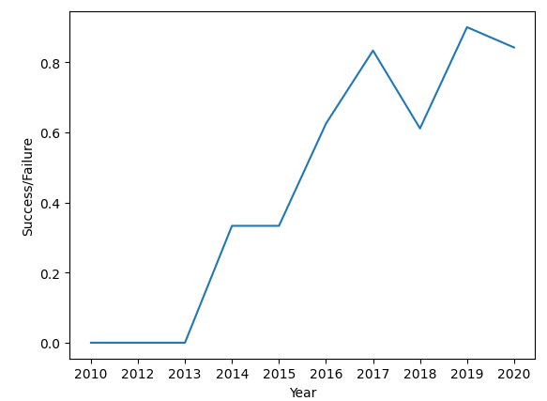
EDA with Data Visualization
Data was visualized using various scatterplots to graph Orbit, Flight Number, and Payload Mass to see the relationships and determine further context.
These plots were color coded by whether a landing was successful or not to grasp more knowledge regarding success rates.
Success rate was graphed over time via line chart (pictured)
Github: Data Visualization Notebook

Slide 14

EDA with SQL
I utilized SQL magic to run various queries on the dataset.
A query to id distinct launch sites
Total payload on boosters contracted through NASA
Determine the average payload for Falcon 9 first stage boosters
The earliest date where a successful ground pad landing occurred.
Where a booster carrying a payload between 4000 and 6000 kg successfully landed on a drone ship
Total number of mission outcomes and by result
The names of the boosters that carried the maximum payload
For 2015, all failed landings on a drone ship, with their booster version and launch site.
All landing outcomes between June 4, 2010 and March 20, 2017 by descending order.
Github: EDA SQL

Slide 15
Build an Interactive Map with Folium
Utilized folium to create map objects such as markers, circles, lines, etc.
Objects added using longitude and latitude data in order to determine distances from landmarks and to determine where launch sites were located.
Aided in understanding where the most successful launches occurred.
Folium Notebook

Slide 16
Build a Dashboard with Plotly Dash
Utilized Plotly Dash to create a dashboard to display launch site data with a pie chart and a scatter plot that could be interacted with via drop down menus.
Pie chart depicts launch site and success rates for each while the scatter plot depicts launch site and payload mass.
Plotly Dash Code

Slide 17
Predictive Analysis (Classification)
Four models were used in this analysis: Logistic Regression, Support Vector Machines, Decision Trees, and K-Nearest Neighbor
The dataset was split between a training set and a testing set to determine the most accurate model.
Machine Learning Notebook
Create model
Split data into Training and Testing
Train model then use test set and compare results

Slide 18

Results
SpaceX uses 4 different launch sites on the East and West Coast with launches done for NASA and SpaceX purposes
Total Payload for all NASA (CRS) contracting flights is 45,596 kg
The Average Payload of a Falcon 9 version 1.1 booster is 2,928 kg
The earliest launch with a successful ground pad landing was on December 22, 2012.
There are 4 boosters that have successfully landed on a drone ship and carried between 4000 and 6000 kgs of payload
There have been a total of 101 flights, with 1 failure and 100 varying levels of success flights.
Interactive analytics demo in screenshots
Predictive analysis results

Slide 19

Results
The majority of launches occur on the East coast
Using the testing set data and the built-in score function found that the Logistic Regression, SVM, and KNN models all performed roughly the same with Decision Trees performing the worst.
Using the built-in best_score function found conflicting results though, with the Decision Tree model performing better than the other three.

Slide 20
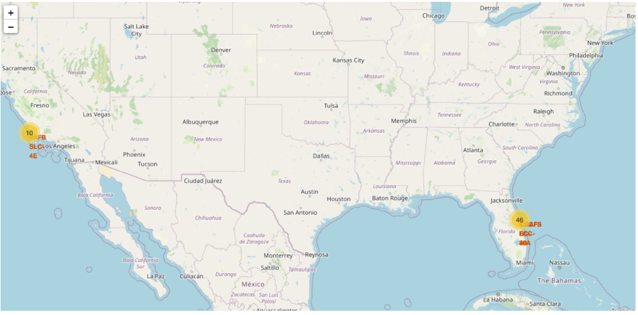
Results
Using interactive visual analytics aided in understanding the launch site data. Specifically, the location of the majority of sites and their distance to surrounding landmarks.

Slide 21

Section 2

Slide 22
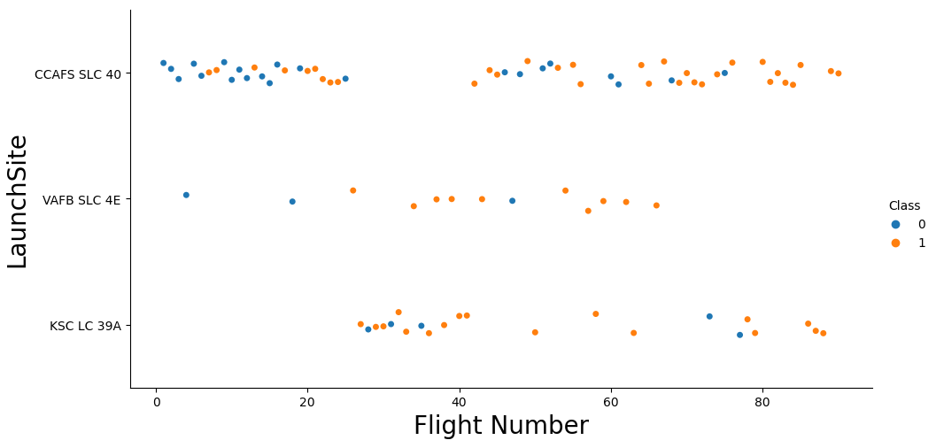
Flight Number vs. Launch Site
Per the scatterplot below, the success rate of flights increased over time as more flights occurred.
The site with the most flights is CCAFS SLC 40 with a higher success rate than others included.

Slide 23
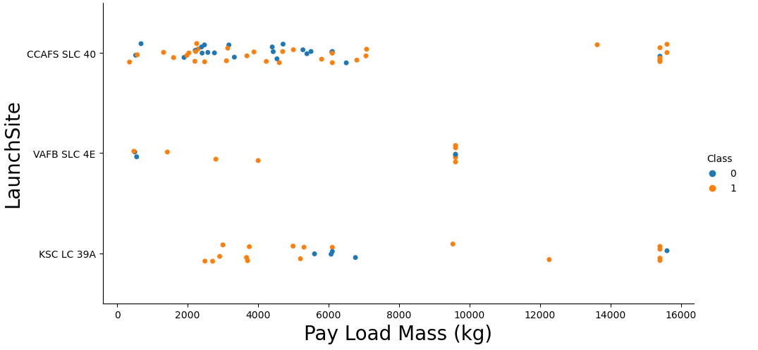
Payload vs. Launch Site
Payload mass tends to be less than 8000 kg for most flights with CCAFS SLC 40 having the majority of flights with it and KSC LC 39A having the highest payload launches.

Slide 24
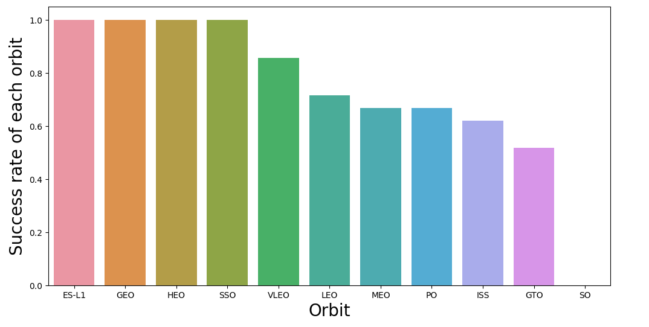
Success Rate vs. Orbit Type
The orbit types with the highest success rate for each orbit are:
ES-L1, GEO, HEO, and SSO with VELO following the pack.

Slide 25
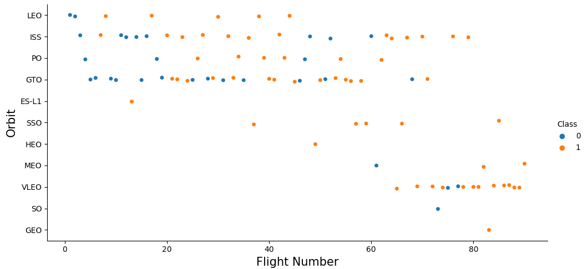
Flight Number vs. Orbit Type
Different orbits have been attempted over time. As the flight number increased, new orbits were attempted while others were continued or discontinued.

Slide 26
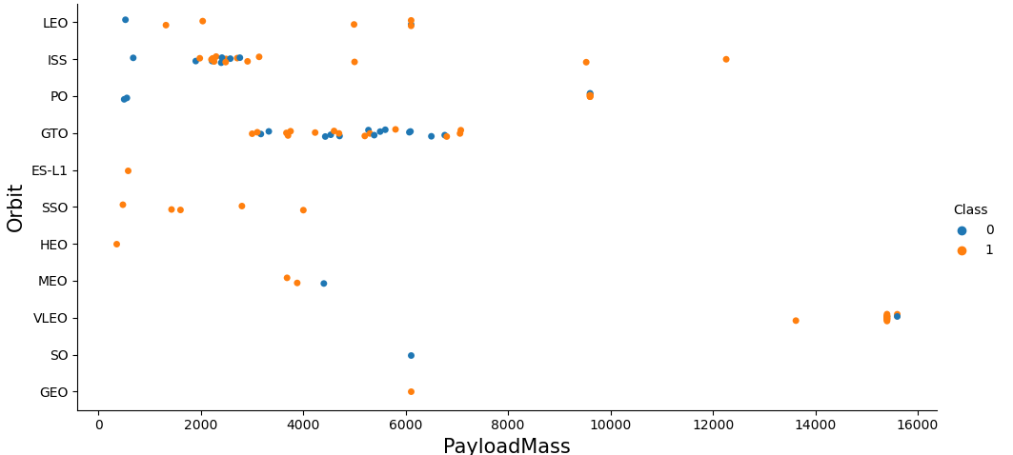
Payload vs. Orbit Type
GTO was used for mid-range payload mass launches while VELO was used for flights with the highest payload masses.
ISS was used for several lower payload mass flights.

Slide 27
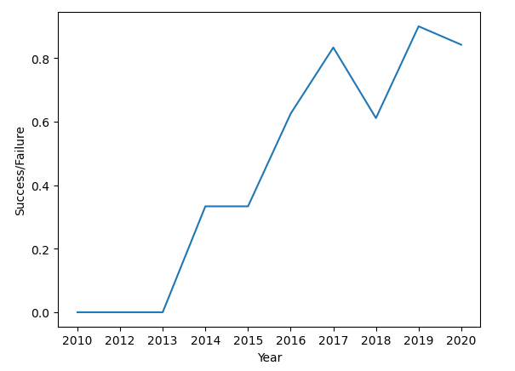
Launch Success Yearly Trend
Success rates over time tend to increase with a slight stabilization or drop in success during specific periods.
Rates increased from 2013 to 2017 before seeing a decline in 2018 and then increasing in 2019.

Slide 28
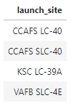
All Launch Site Names
There were four launch sites used by SpaceX for flights contracted through NASA (CRS).
These sites were located on the West Coast and East Coast of the United States.

Slide 29
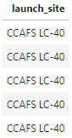
Launch Site Names Begin with 'CCA'
There were 5 flights using the CCAFS LC-40 launch site contracted with NASA (CRS)

Slide 30
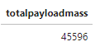
Total Payload Mass
The total payload mass for flights contracted with NASA performed by SpaceX was 45,596 kg.

Slide 31
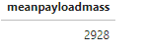
Average Payload Mass by F9 v1.1
The average payload for a Falcon 9 V1.1 booster is 2,928 kg.

Slide 32
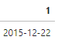
First Successful Ground Landing Date
The first successful ground pad landing for a flight occurred on December 22, 2015.

Slide 33
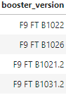
Successful Drone Ship Landing with Payload between 4000 and 6000
4 boosters have successfully landed on a drone ship after carrying a payload between 4000 and 6000 kg.

Slide 34
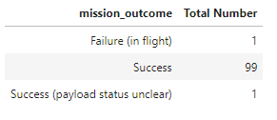
Total Number of Successful and Failure Mission Outcomes
There have been 101 total flights with:
1 failure
99 successes
1 success with an unknown payload status

Slide 35
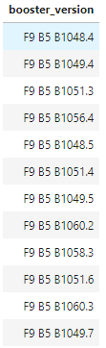
Boosters Carried Maximum Payload
There have been 12 boosters to carry the maximum payload. The landing outcome for each was not checked but a follow up analysis could discover this.

Slide 36
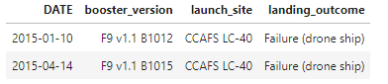
2015 Launch Records
There were 2 failed booster landings on a drone ship in 2015.
One occurred on January 10 and the other occurred on April 14, with both taking off from the CCAFS LC-40 launch site and both were Falcon 9 v1.1 boosters.

Slide 37
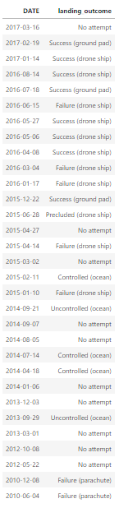
Rank Landing Outcomes Between 2010-06-04 and 2017-03-20
There were 31 flights scheduled between June 4, 2010 and March 20, 2017.
Of the 31 flights, there were:
3 successful ground pad landings
5 successful drone ship landings
5 failed drone ship landings
2 failed parachute deployments
3 controlled landings into the ocean
2 uncontrolled landings into the ocean
10 flights with no attempted landings
1 classified as precluded drone ship landing

Slide 38

Section 3

Slide 39
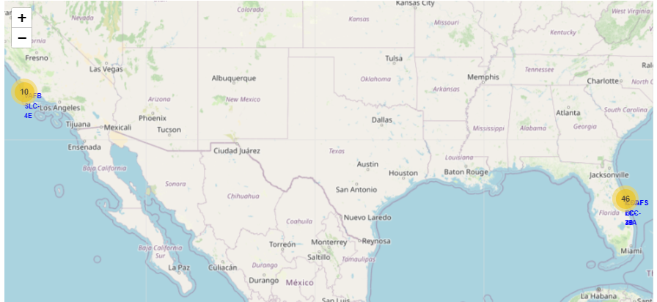
Geographic Visualizations
There were 46 launches on the east coast and 10 launches on the west coast.

Slide 40
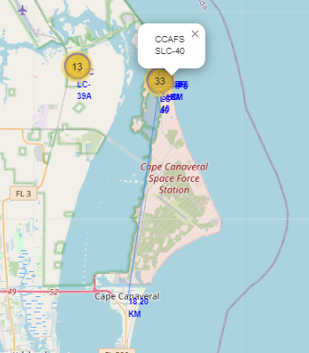
Geographic Visualizations
Folium was used to create land markers regarding the launch sites and to local fixtures such as Cape Canaveral to see to distance between the city and the launch site.
This determine the distance between the launch site and these fixtures using longitudinal and latitudinal data.

Slide 41
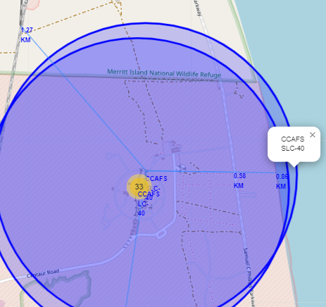
Geographic Visualizations
Folium was used to create land markers regarding the launch sites and to local fixtures such as the coast, the nearest highway, and railroad.
This determine the distance between the launch site and these fixtures using longitudinal and latitudinal data.

Slide 42

Section 4

Slide 43
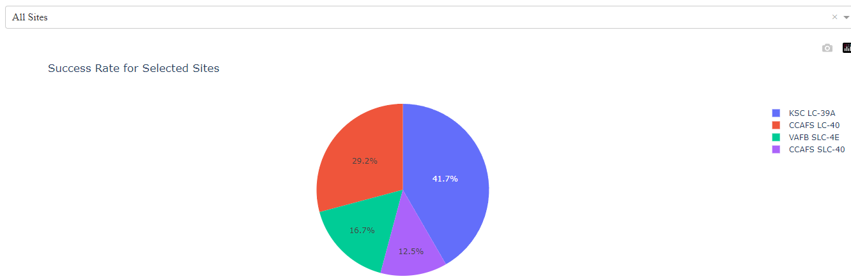
Launch Success for All Sites
The success rate for all sites varies by site with KSC LC-39A having the highest at 41.7%. Followed by CCAFS LC-30, VAFB SLC-4E, and CCAFS SLC-40

Slide 44
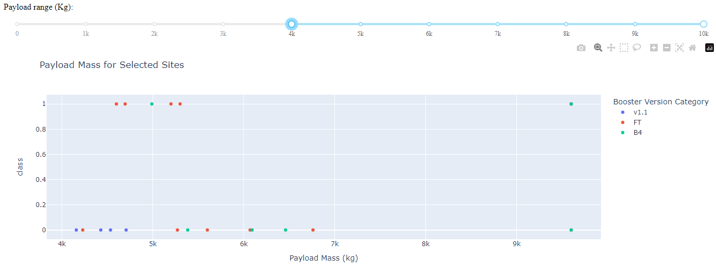
Payload Mass for All Boosters
The payload mass of 4000 kg and above for all booster versions used.
Only the V1.1, FT, and B4 boosters were used for payload masses above 4000 kg.

Slide 45

Section 5

Slide 46
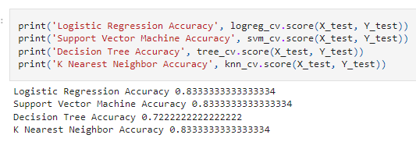
Classification Accuracy
Of the 4 models used, the Decision Tree model had the weakest accuracy. While the remaining models all tied for accuracy.

Slide 47
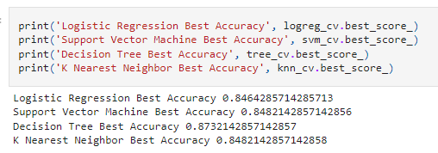
Classification Accuracy
When using a different built-in score function, the Decision Tree model produced the best accuracy of the four models with KNN and SVM tying and the Logistic Regression placing last.

Slide 48

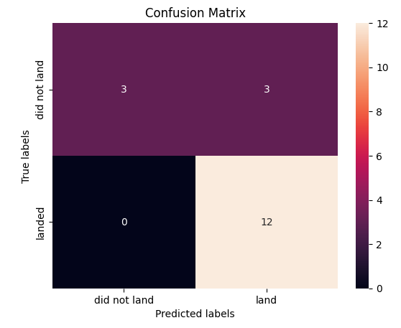



Confusion Matrix
The Decision Tree model predicted that 12 would land and 0 would fail to land, when 3 actually failed to land.

Slide 49
Conclusions
There are several launch sites used by SpaceX for NASA contracted missions
Payload mass varies based on booster, orbit, launch site, and year.
Landing outcomes vary based on mission parameter, specifically if it is landing on a ground pad or drone ship
Data Visualizations aid in understanding the relationship between orbit, landing outcome, payload mass, and booster type.

Slide 50
Conclusions
Machine Learning results vary by model with accuracy fluctuating depending on how it is measured.
Even the most accurate model will have a measurement error and not accurately predict 100% of the time.
However, given the results of these models an estimate can be made regarding the landing outcome of a given flight based on booster, year, and payload mass.

Slide 51
Appendix
Data Collection
Webscrapping
Data Wrangling
EDA SQL
Data Visualization
Folium
Plotly Dash
Machine Learning

Slide 52


